Slide 1

Project [STATS & EDA]
PART A (STATS) – INFERENTIAL ANALYSIS ON AGE OF
ZEN AUTOMOTIVES CUSTOMERS
PART B (EDA) – BASKETBALL DATASET
Submitted by : Gayatri Patil

Slide 2
Problem Definition
Dataset – Zen Automotives
Problem Statement :
Utilize core statistical theoretical concepts and knowledge to solve the questions and write inferences based on the observation of the solutions.

Slide 3
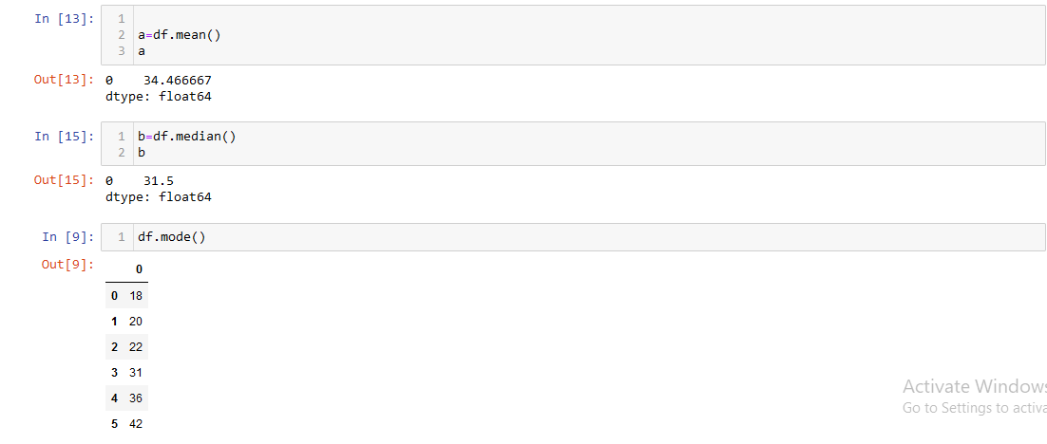
Q.1. Compute the mean, median and the mode of the data.
-Provide Understanding
By summing all the numbers in a data collection and dividing by the total number of values in the set, the mean (average) of the data set can be determined. A data collection is ordered from least to largest, and the median is the midpoint number. The data set's mode is the number that appears the most frequently.
-Code Snippet and Solution

Slide 4
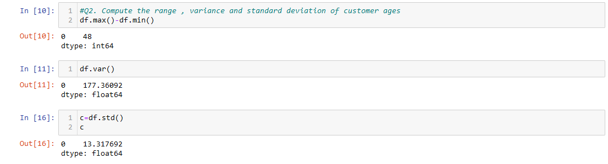
Q.2. Compute the range, variance and standard deviation of customer ages.
-Code Snippet and Solution

Slide 5
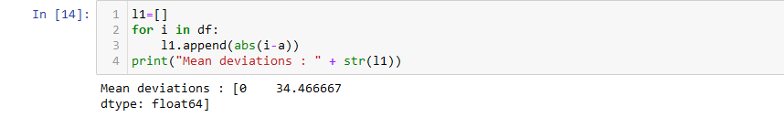
Q.3. Find the mean deviation for the data. The mean deviation is defined as below.
-Provide Understanding
Determine the mean, median, or mode value for the given data set in step 1. Step 2 - After that, ignoring the signs, we must calculate the absolute difference between each value in the data set and the mean. Step 3- Involves totaling all deviations. Step 4- The final step is to calculate the mean or average of the variables from Step 3.
-Code Snippet and Solution

Slide 6
Q.4.Calculate the Pearson coefficient of skewness and comment on the skewness of the data.
- Code and Snippet
-Inference
the data is positively skewed since the output is greater than 0 and less than 3

Slide 7
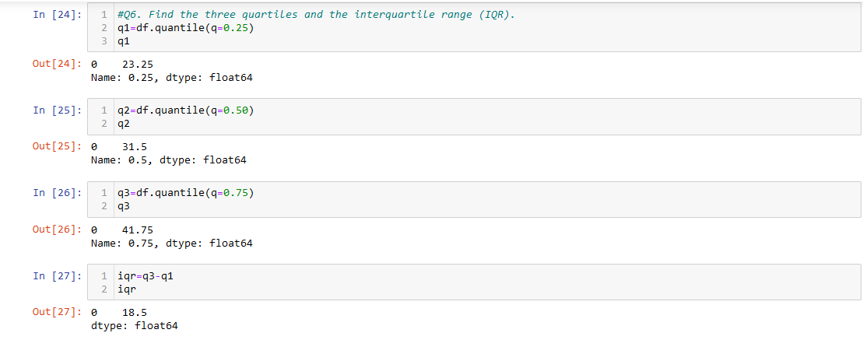
Q.5. Count the number of data values that fall within two standard deviations of the mean. Compare this with the answer from Chebyshev’s Theorem.
-Code and Snippet

Slide 8
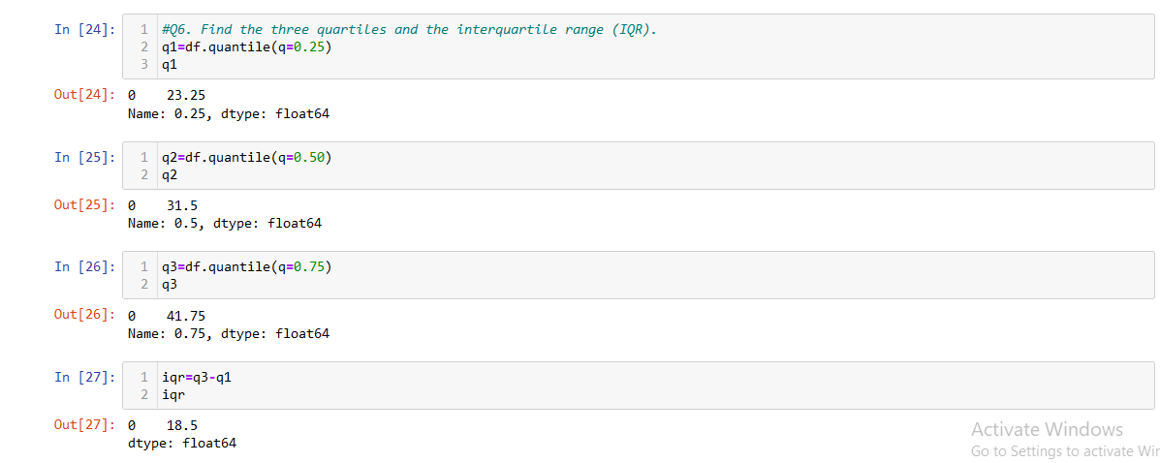
Q.6. Find the three quartiles and the interquartile range (IQR).
-Code Snippet and Solution

Slide 9
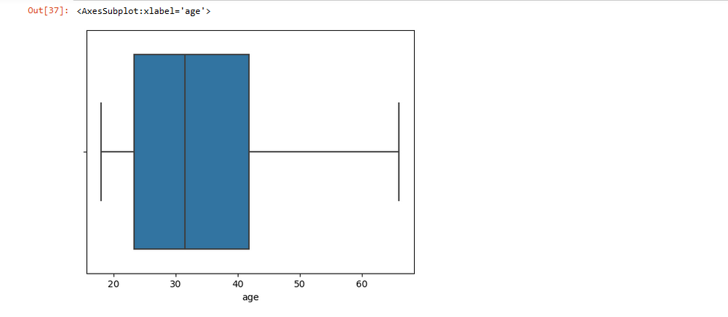
Q.7. Are there any outliers in the data set?
-Code Snippet and Solution

Slide 10
Q.8. Draw a boxplot of the dataset to confirm.
-Code Snippet
-Solution
-Inference
there are no outliers in the dataset

Slide 11
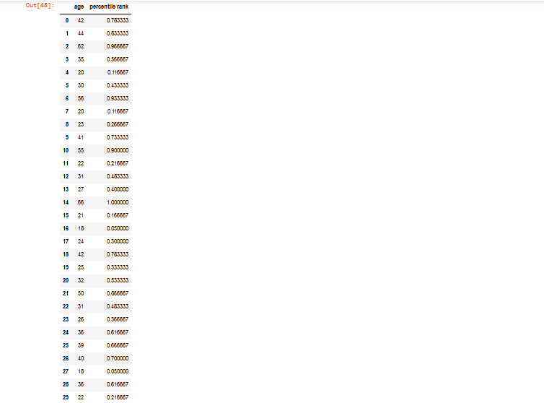
Q.9. Find the percentile rank of the datapoint 50.
-Code Snippet
-Solution
-Inference

Slide 12
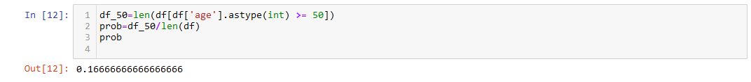
Q.10. What is the probability that a person ordering an EV scooter is above 50 years old?
-Code Snippet and Solution
-Inference
The probability of age of the customers for the vehicle being above 50 is 0.16.

Slide 13
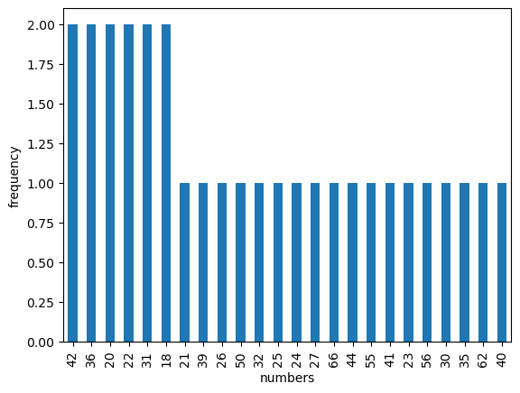
Q.11. Create a frequency distribution for the data and visualize it appropriately.
-Code Snippet
-Solution
-Inference

Slide 14
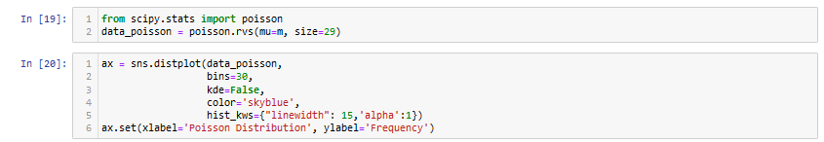
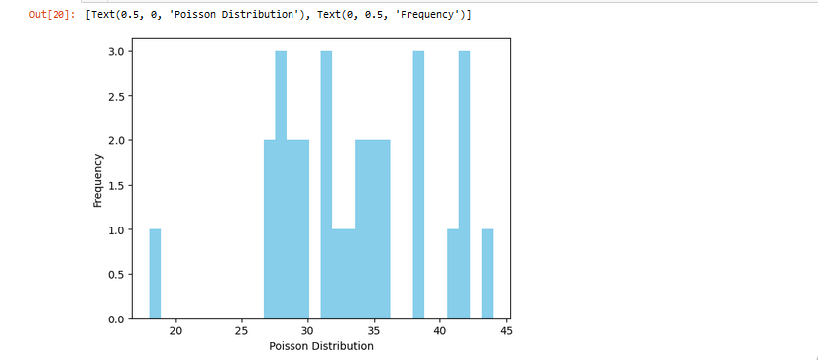
Q.12. Create a probability distribution of the data and visualize it appropriately.
-Code Snippet
-Solution

Slide 15
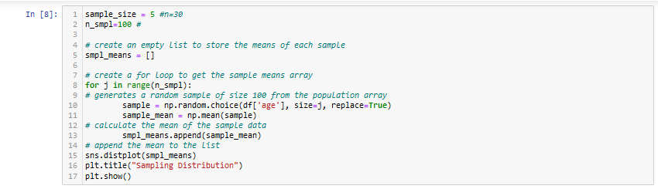
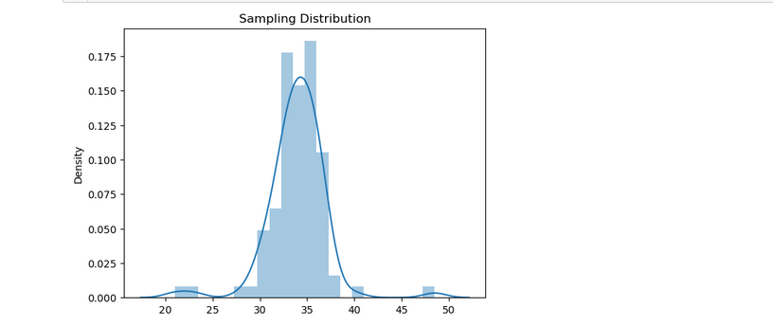
Q.13. What is the shape of the distribution of this dataset? Create an appropriate graph to determine that. Take 100 random samples with replacement from this dataset of size 5 each. Create a sampling distribution of the mean age of customers. Compare with other sampling distributions of sample size 10, 15, 20, 25, 30. State your observations. Does it corroborate the Central Limit Theorem?
-Code Snippet
-Solution
-Inference

Slide 16
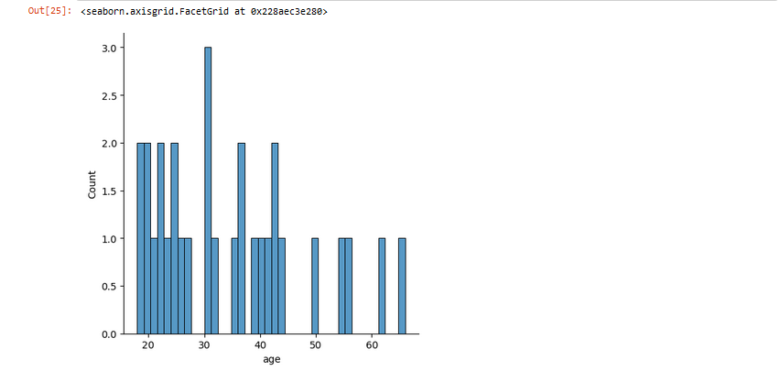
-Code Snippet
-Solution

Slide 17
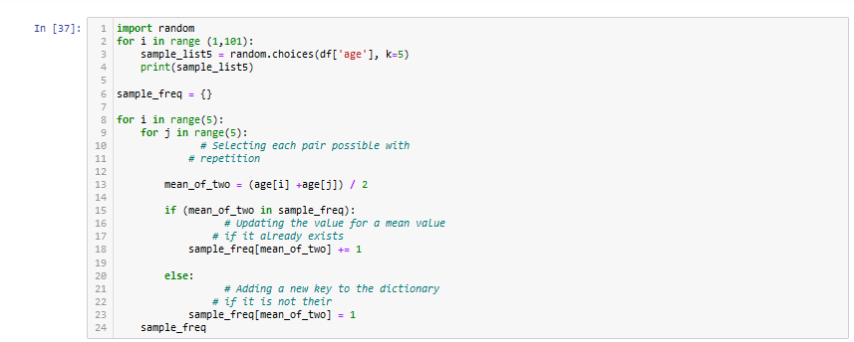
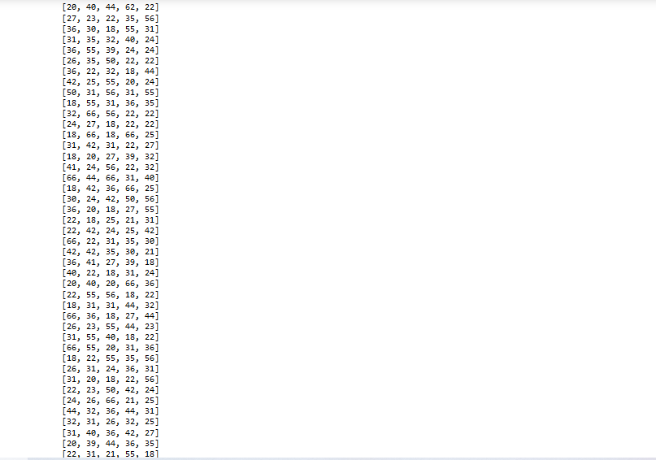
-Code
-Solution

Slide 18
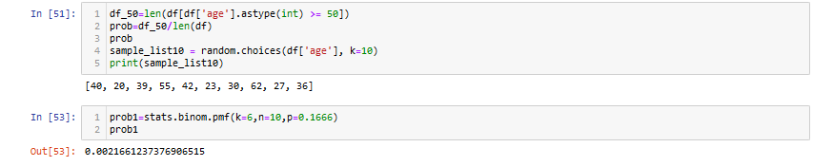
Q.14. Treat this dataset as a binomial distribution where p is the probability that a person ordering an EV is above 50 years age. What is the probability that out of a random sample of 10 buyers exactly 6 are above 50 years of age?
-Code Snippet and Solution

Slide 19
Q.15. A study claims that 10% of all customers for an EV scooter are above 50 years of age. Using the Normal approximation of a Binomial distribution, find the probability that in a random sample of 300 prospective customers exactly 25 will be above 50 years of age.
-Code Snippet and Solution

Slide 20
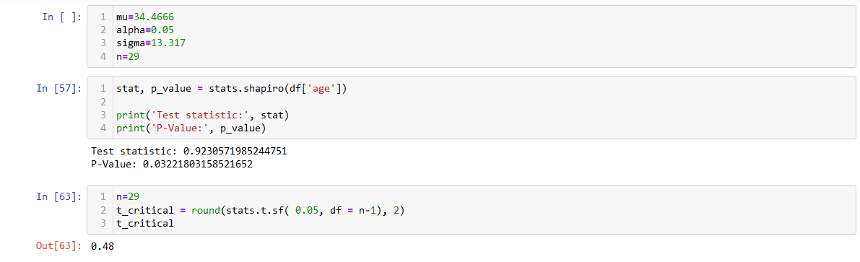
Q.16. Compute a 95% Confidence Interval for the true mean age of the population of EV scooter buyers for the dataset using appropriate distribution. (State reasons as to why did you use a z or t distribution)
-Code Snippet and Solution

Slide 21
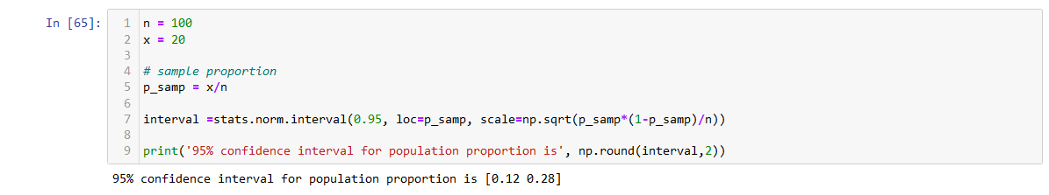
Q.17. A data scientist wants to estimate with 95% confidence the proportion of people who own an EV in the population. A recent study showed that 20% of people interviewed had an EV. The data scientist wants to be accurate within 2% of the true proportion. Find the minimum sample size necessary.
-Code Snippet

Slide 22
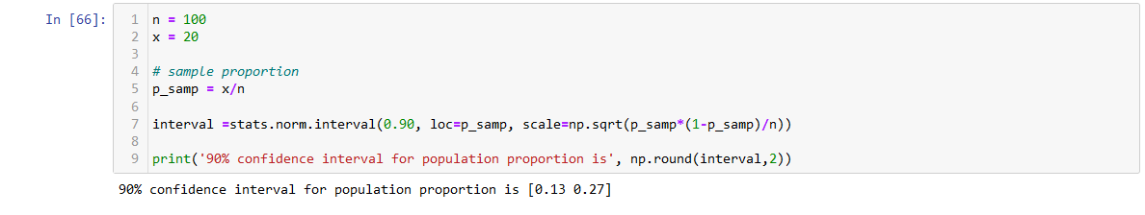
Q.18. The same data scientist wants to estimate the proportion of executives who own an EV. She wants to be 90% confident and accurate within 5% of true proportion. Find the minimum sample size necessary.
-Code Snippet and Solution

Slide 23
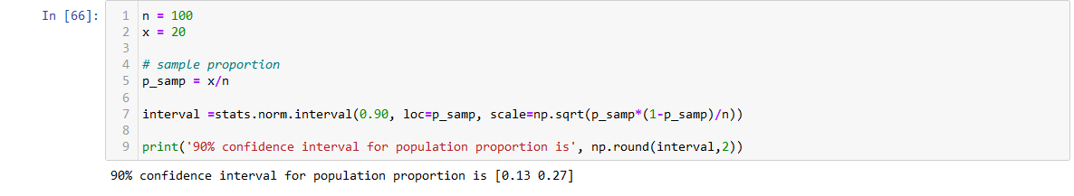
Q.19. A researcher claims that currently 20% of the population are owning EVs. Test his claim with an alpha =0.05 if out of a random sample of 30 two-wheeler owners only 5 own an EV.
-Code Snippet

Slide 24
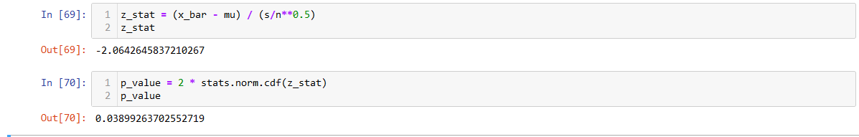
Q.20. Assume you are working for a Consumer Protection Agency that looks at complaints raised by customers for the transportation industry. Say you have been receiving complaints about the mileage of the latest EV launched by the Zen Auto-motives. Zen allows you to test randomly 40 of its new EVs to test mileage. Zen claims that the new EVs get a mileage of 96 kmpl on the highway. Your results show a mean of 91.3 kmpl and a standard deviation of 14.4.
-Code Snippet
A . Show why you support Zen’s claim using the P-value obtained.

Slide 25
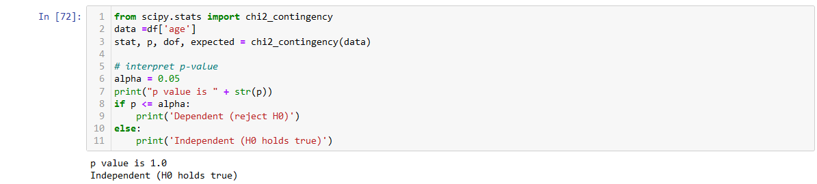
B. After more complaints you decide to test the variability of the mileage on the highway.
On questioning Zen’s quality control engineer,
you find that they are claiming a standard deviation of 7.2. Test the claim about the standard deviation.
-Code Snippet & Solution

Slide 26
Write a summary of results and the action that Zen must take to remedy the complaints
-Solution
zen must take a larger sample size and check again the p value if then the null hypothesis remains true, he must change the claimed mileage.

Slide 27
D. What is your position on performing the test for variability along with the test for means?
-Solution
Performing the test of means on the above dataset concludes that the customer claim stands true that is the null hypothesis is accepted and zen should change the claim of the mileage offered by the EV.

Slide 28
Q.21. Write a report comparing and contrasting Descriptive vs Inferential Statistics in about 200-500 words and how each helps to get more insight into the data at hand.
-Solution
Descriptive Statistics: Descriptive statistics is a term given to the analysis of data that helps to describe, show and summarize data in a meaningful way. It is a simple way to describe our data.
Descriptive statistics is very important to present our raw data ineffective/meaningful way using numerical calculations or graphs or tables.
This type of statistics is applied to already known data.
Descriptive statistics are used to describe the characteristics or features of a dataset.
The term ‘descriptive statistics’ can be used to describe both individual quantitative observations (also known as ‘summary statistics’) as well as the overall process of obtaining insights from these data.
We can use descriptive statistics to describe both an entire population or an individual sample.
Because they are merely explanatory, descriptive statistics are not heavily concerned with the differences between
the two types of data. So, what measures do descriptive statistics look at? While there are many, important ones include:
Distribution
Central tendency
Variability

Slide 29
Inferential Statistics: In inferential statistics, predictions are made by taking any group of data in which you are interested.
It can be defined as a random sample of data taken from a population to describe and make inferences about the population.
Any group of data that includes all the data you are interested in is known as population.
It basically allows you to make predictions by taking a small sample instead of working on the whole population.
we’ve established that descriptive statistics focus on summarizing the key features of a dataset. Meanwhile, inferential statistics focus on making generalizations about a larger population based on a representative sample of that population. Because inferential statistics focuses on making predictions (rather than stating facts) its results are usually in the form of a probability.
Unsurprisingly, the accuracy of inferential statistics relies heavily on the sample data being both accurate and representative of the larger population.
To do this involves obtaining a random sample. If you’ve ever read news coverage of scientific studies,
you’ll have come across the term before. The implication is always that random sampling means better results.
On the flipside, results that are based on biased or non-random samples are usually thrown out.
Random sampling is very important for carrying out inferential techniques.

Slide 30
Problem Definition
Dataset – Basketball dataset
Problem Statement :
Report building using EDA and visualization techniques to help the business, take decisions using insights from the data

Slide 31
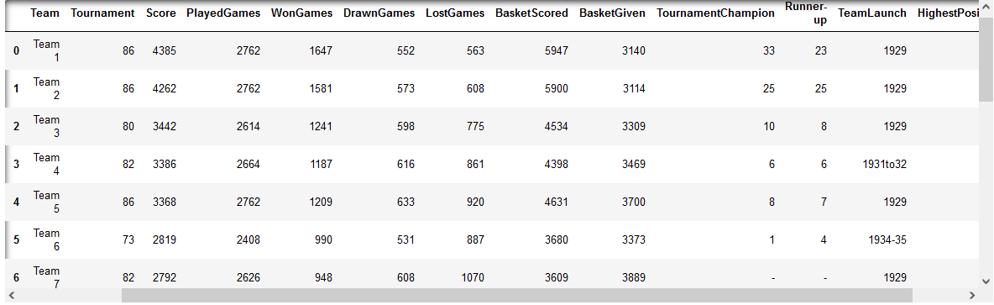
Q.1. Read the data set, clean the data and prepare a final dataset to be used for analysis
-Code Snippet
-Solution

Slide 32
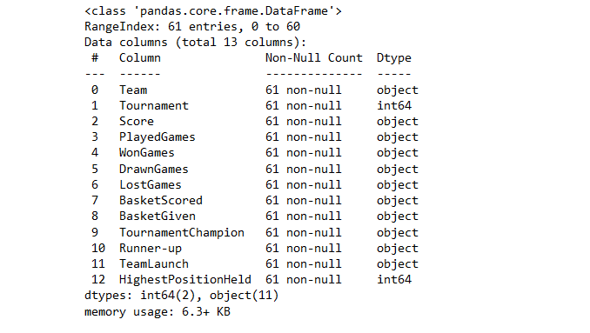

Slide 33
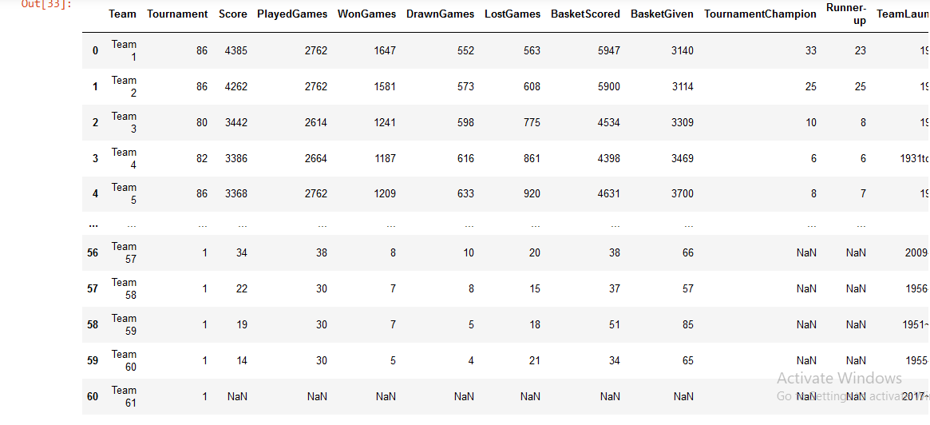

Slide 34
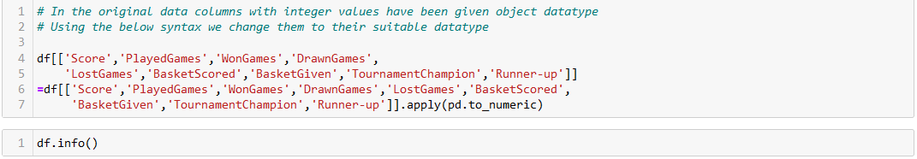
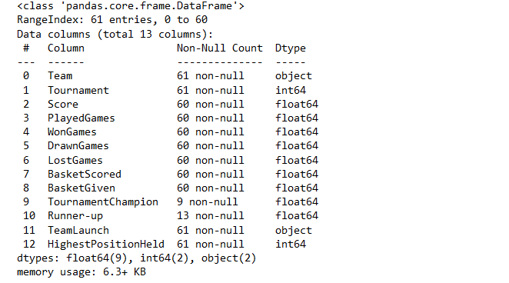

Slide 35
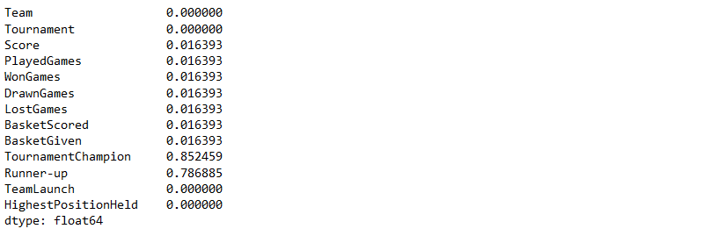
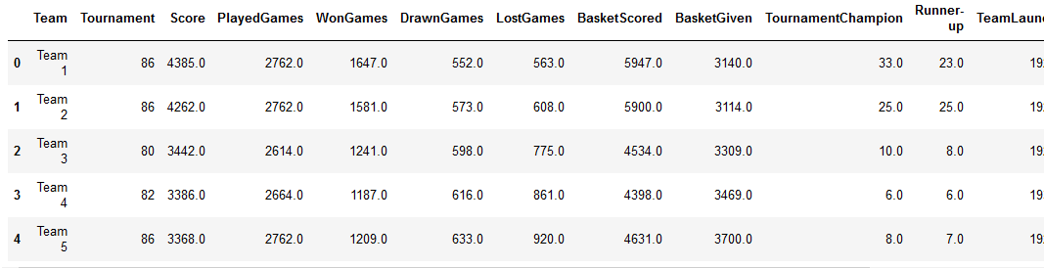

Slide 36
Q.2Perform detailed statistical analysis and EDA using univariate, bi-variate and multivariate EDA techniques to get data driven insights on recommending which teams they can approach which will be a deal win for them.. Also as a data and statistics expert you have to develop a detailed performance report using this data
A. Find the correlation between the columns of the dataset.

Slide 37
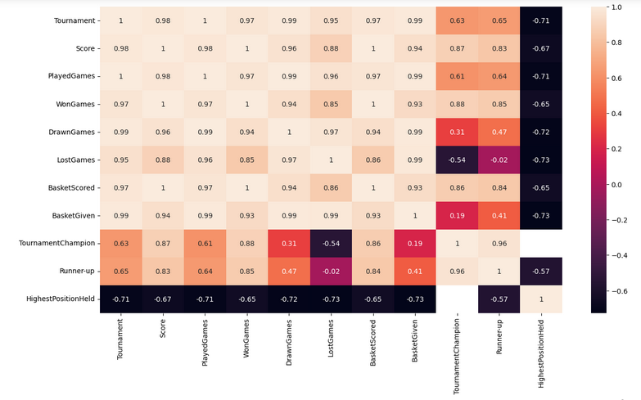
Output

Slide 38

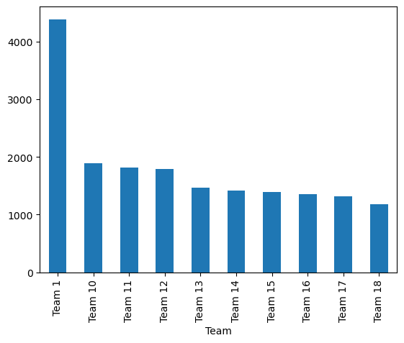
B. Teams who scored the highest throughout all the tournaments

Slide 39
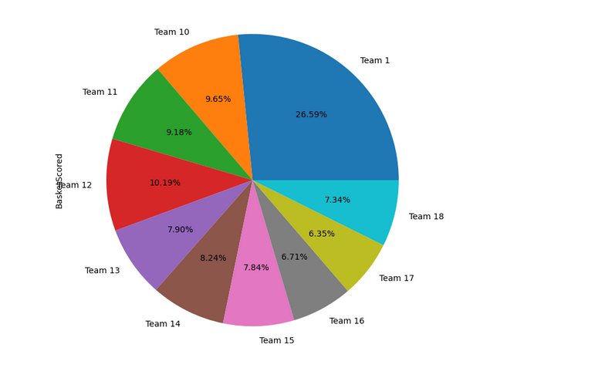
C. Teams who scored the most baskets

Slide 40
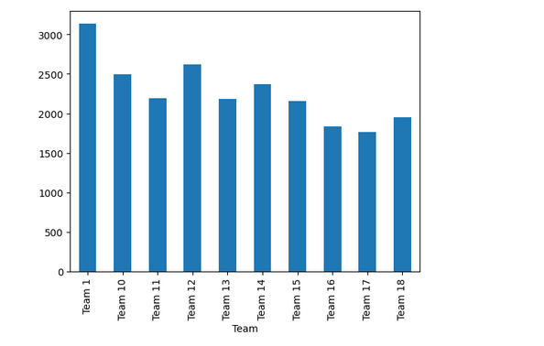
D. Teams who gave the most number of baskets in tournaments overall.

Slide 41
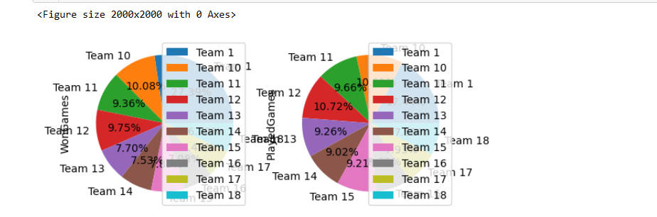
E. Relation between played games and won_games by teams

Slide 42
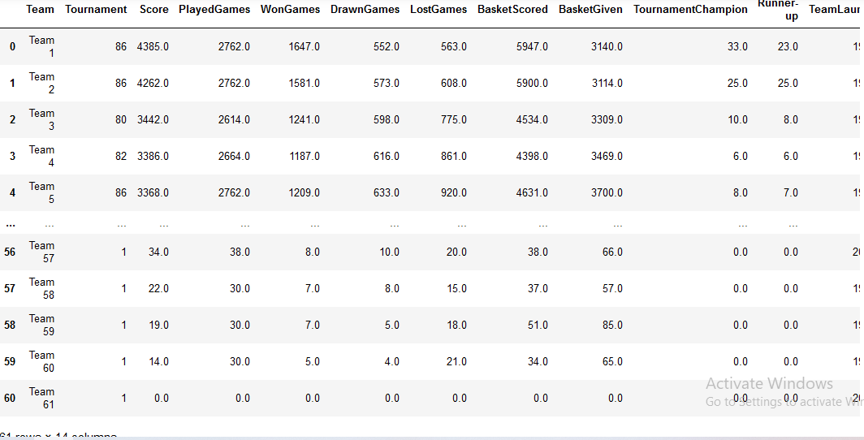
F. we will now calculate the winning percentage according to the following formula: wins+ 0.5*ties/total games * 100%

Slide 43
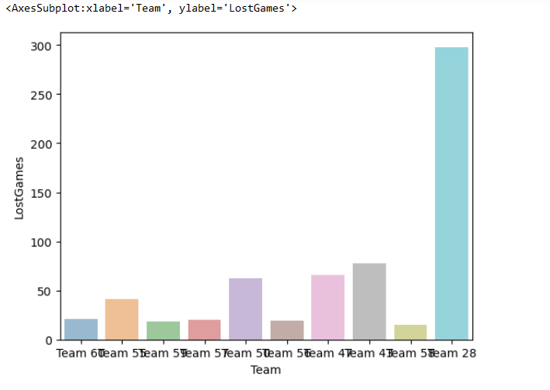
G. Teams with lowest performance

Slide 44
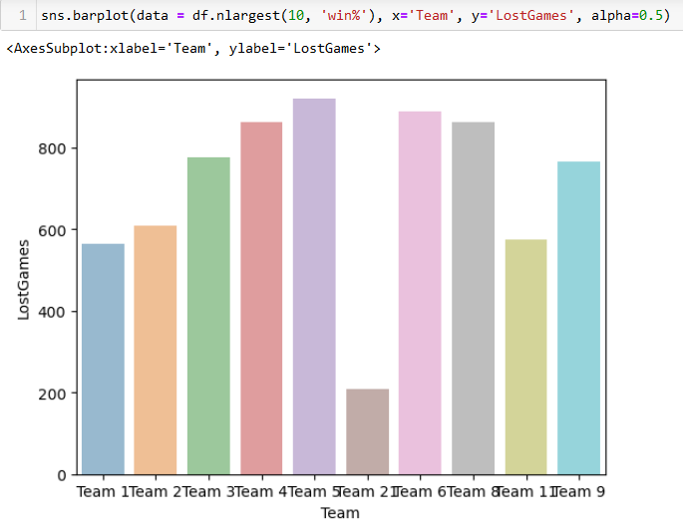
H . Teams with highest performance.

Slide 45
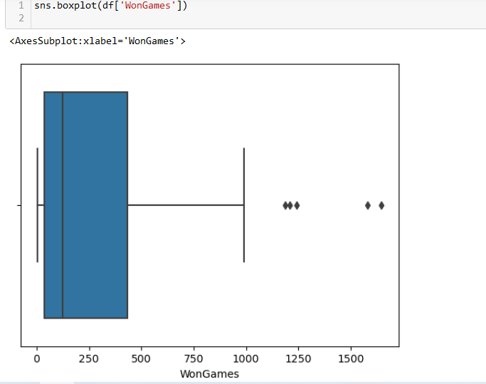
I. Finding outliers.

Slide 46
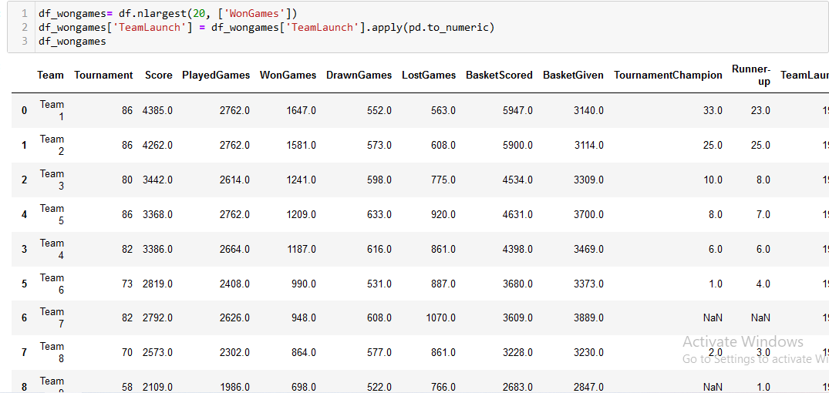
K . Creating data frame according to the team won and winpercent and plotting the pie chart for teams won the most champion trophies in tournament. -Code Snippet and Output

Slide 47
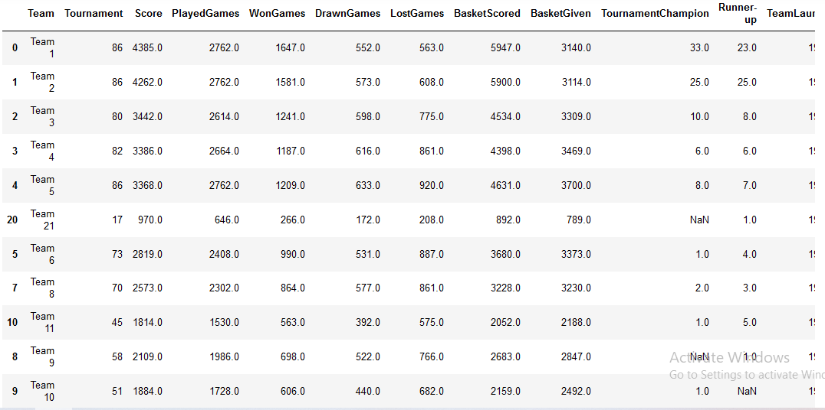

Slide 48
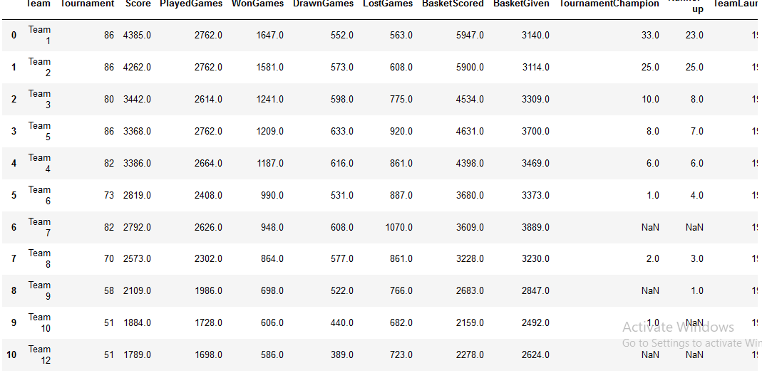

Slide 49
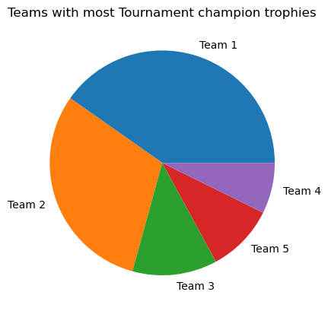
-Code Snippet and Output

Slide 50
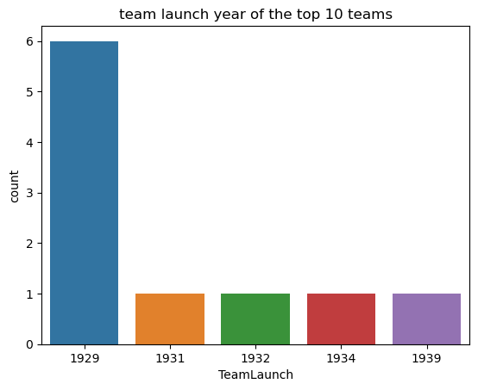
L . Top 10 team launch years. -Code Snippet and Output

Slide 51
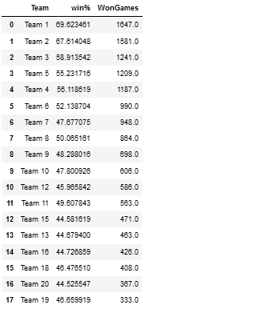
-Code Snippet and Output

Slide 52
Q.3. Please include any improvements or suggestions to the association management on quality, quantity, variety, velocity , veracity etc. on the data points collected by the association to perform a better data analysis in future . Submit a 200-500 words report to the management.
-Solution
Quality:
Some of the columns had mixed data like Team Launch,
special instructions can be mentioned while adding the data like
only enter the year of team formation' to avoid this.
Quantity:
Since our dataset had only 61 entries, we couldn't figure out more trends. We can include information about the players of each team, at least of the captains.
It would have given us some information about the team's performance under different captains.

Slide 53
Velocity:
efficient speed of data collection can be achieved
if we maintain a regular record of the games, keep adding data after every match.
Variety:
Again, more information about the team players can help us add variety to the data and will help us understand trends over the years.
Conclusion:
Company X can approach the top 5 teams namely Team 1,2,3,4,5 since they have the highest score,
max no of baskets scored, max winning % and most

Slide 54
Thank You….

